Slide 1




Slide 2

TARGET MARKET
Professionals
Students
Caretakers
Patients
VALUE PROPOSITIONS
Mental health parity
Free of cost
User support and satisfaction
Improved health outcomes.

Slide 3

Pain Points
-Users/Care Takers find it difficult to access the appropriate resources
- Users aren't getting the help they need at difficult times.
-Users become addicted to
medication, which has
long-term consequences for
them.
- Users are spending money on health apps without realizing what their problem is, resulting in a waste of money.

Slide 4

WHY BETTERU?
As a community service, BetterU will make mental health services available for free.
The current market applications are subscription-based, whereas BetterU provides a community-driven solution for patients.
We provide fast assistance to users through professional-recommended blogs and videos.
It will benefit behavioral health patients, who require specific attention.
It will be beneficial for psychology students to put their knowledge into practice and assist persons with mental health concerns.
Professionals can give their time to help the community achieve its aim of giving back.

Slide 5

KEY WINNING FACTORS
It is a community-driven program that is free to use.
With the support of psychology students and experts, we plan to deliver community service.
For both students and patients, it's a win-win scenario.
We intend to raise donations and assist people who are experiencing financial difficulties.

Slide 6









CAPABILITIES
Activity board
Blog
Notifications
Doctor appointments
Articles
YouTube videos
Questionnaire

Slide 7

JUSTIFICATION
Our maxim is to help the mental illness patients to over come the circumstance with a “community driven application” with the assistance of Psychology students
and doctors.

Slide 8


Implementation is perfectly done
Training and testing of the application is done
Integrating all the scripts and installing all the required software's is completed successfully
Users can easily access the portal without any hassle.
Doctors are available to give the medication and suggestions for the patients present mental health condition
CURRENT STATUS

Slide 9


Slide 10


Slide 11

BUSINESS MODEL
Collaborating with patients and their caregivers on their condition.
Our application is a community-driven business concept that is available for free.
Activity group with psychology students who can assist people based on their medical needs.
We intend to gather donations to assist users in meeting their necessities throughout their financial difficulties.

Slide 12


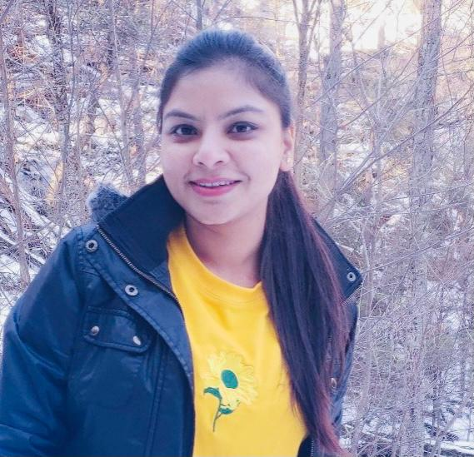
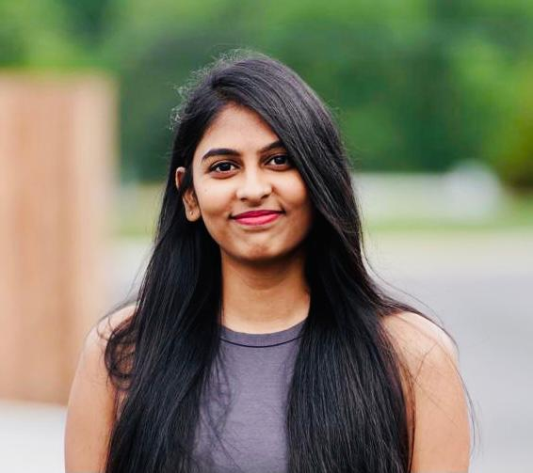
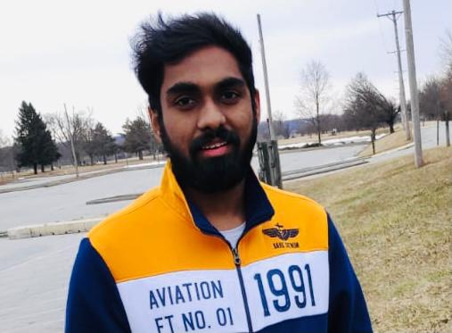
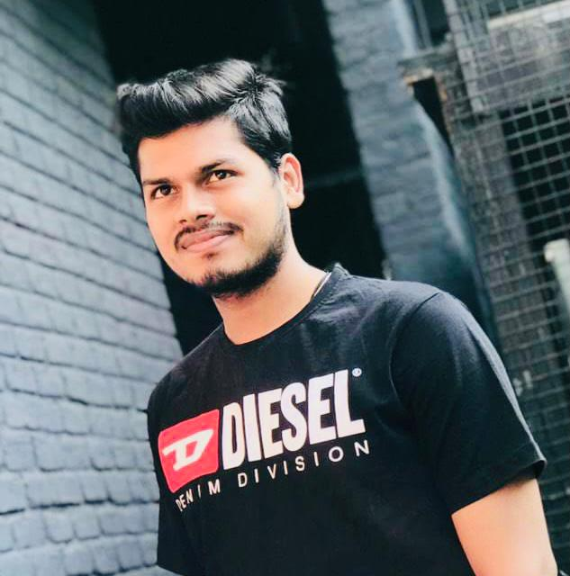
TEAM
Annapurna Marella
Anju Madhukar
Annapurna Marella - Ui and Ux developer, Application Design.
Lakshmi Haritha –Database designer, Requirement Gathering.
Pavan Kumar –Ui and Ux Developer, Testing.
Anju Madhukar-Jsp server, Deployment.
Srimithra-Testing and Solution Architect.
Lakshmi Haritha
Srimithra
Kancharakuntla
Pavan Kumar
Jannaikode

Slide 13

IMPLEMENTATION
Experimenting different tools and technologies.
Requirement gathering and analysis.
Software Development Life Cycle.
Agile Methodology.
Quality assessment.

Slide 14

Technical Validation and Scale up
Validation:
While coming to any application trust plays a major role from the customer side ,we the BetterU team is providing good support and mental parity.
Scale –UP:
Our plan is to provide the community driven application with the help of Doctors and Psychology students.
We are providing a fund raise icon so that any anyone can donate funds.

Slide 15

Thank You
-BetterU Team

